Slide 1
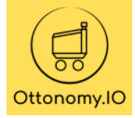
Industrial Training Presentaton
Robotics Software Intern at OttonomyIO
Submitted By:
R.Prashant
2k18/EC/124
Section:E

Slide 2
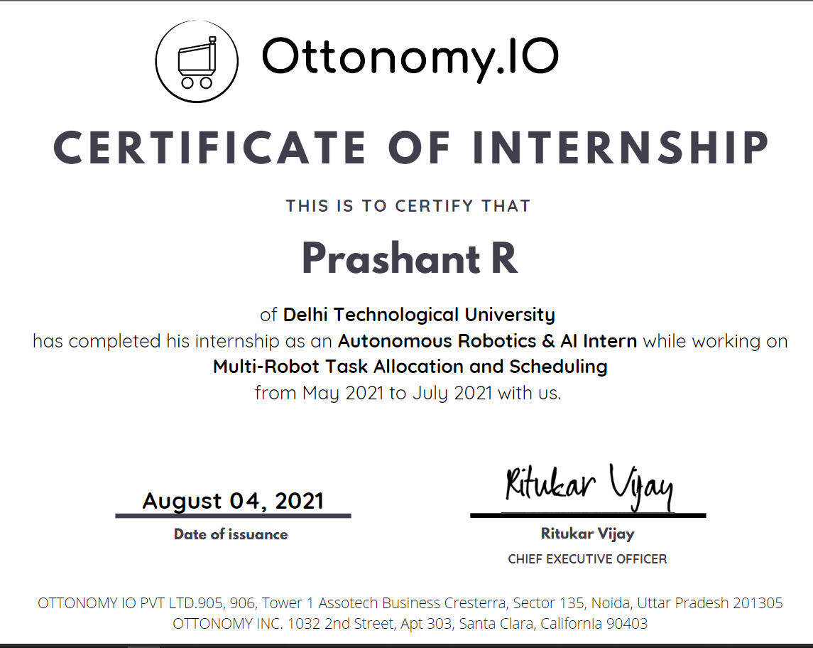
Certificate

Slide 3
INTRODUCTION
About OttonomyIO
OttonomyIO is an American corporation headquartered in Santa Monica,California which works with Autonomous and Contactless Delivery.
Website: https://www.ottonomy.io/how-it-works/
https://www.linkedin.com/company/ottonomyio
It was launched in 2020.
The team's DNA is to convert adversity into opportunity. That's how the company started in the midst of a global pandemic. The team at ottonomy together has decades of experience at building autonomous technology and we take immense pleasure in building services that can significantly improve and enhance the quality of delivery services by introducing best-in-class and friendly service robots. They firmly believe in building a workplace that inspires. You'll discover a creative, collaborative atmosphere at Ottonomy, where brilliant ideas flourish and everyone is motivated by the same huge goal.

Slide 4
OttonomyIO’s Products
The online buying and delivery landscape is changing rapidly and in 2020, digital sales increased by +234% and local last-mile and curbside deliveries by 700%
To address exponential growth with sustainable margins and massive labor shortages, we move towards this path provide systems that are better than what we have today, Ottonomy currently operates for Curbside, Last-mile and Indoor deliveries.
Curbside delivery saw a major uptick in recent years. The team is redefining the curbside deliveries wherein the robots can bring items from inside the store to the parking lots. Using Ottonomy’s tech stack which works seemlessly for indoor and outdoor environment enable retailers and restaurants to deliver products faster and sustainable. Retailers can leverage their physical store networks to provide a competitve advantage compared to online or doorstep deliveries
The goal of last-mile local delivery is to transport an item to its recipient in the quickest way possible. But often this stage of delivery is the least efficient, and attributes to almost 53% of the total cost of the entire lifecycle of the package to be delivered.

Slide 5
Airports / Resorts Delivery
With Ottonomy’s unique positioning and tech capabilities they provide deliveries in dynamic and time sensitive areas like airports. Ottonomy is able to conduct deliveries inside an airport due to its contextual mobility navigation and addressing a gap which is yet open.
Similar to this the robots can also work with large resorts to help staff shortage and work with minimal staff to provide deliveries within indoor and outdoor environments. No more queuing up for getting you favourite byte !

Slide 6
BEFORE THE INTERNSHIP
Selection Process
The selection Process consisted of interview rounds with the company where I was assessed on the basis of my past experiences and my creativity to think on solutions which would help improve upon their current scope of work.

Slide 7
Job Profile
I was hired by Ottonomy for the position of the Robotics Software Intern. The job role dealt with mainly path planning and scheduling of the multi robot system .It was a Virtual internship owing to the pandemic situation (COVID 19).
SKILLS LEARNT
The complete internship was a stupendous learning journey.The skills I learnt included algorithmic programming and working on with difficult algorithms like Held Karp algorithm for multi robot Travelling Salesman Problem using C++ .

Slide 8
WEEK WISE REPORT
Week 1
Week one was basically virtual onboarding .
The first week I met with the founders,Pradyot Korupolu and Ritukar Vijay sir.Both of them had immense knowledge with the robotics industry having worked in it for more than a decade.They were more than supportive and well acquainted with all the knowledge required for the project.I met with my mentor,Jayanth Krishna Mowgli who was incredibly supportive to me throughout the duration of the internship.He helped us at every step of the internship.He is currently pursuing his Masters in Operations Research from RISS,Carnegie Mellon University,USA which is one of the most premium institutes of research in the world.In the course of the internship we learnt that he was GATE AIR 30 during his days.An incredible and passionate guy ,we were really humbled to be under his guidance and learn a lot of stuff from him.The other person I was introduced to in the first week was my buddy who was in the same team as me:Tushar.He is currently pursuing his BTech in Mechanical Engineering from IIT-BHU.His contributions during the course of the internship helped me sail through the overwhelming tides during the course of the project.Any problem I faced I knew I could rely on this guy for help. We also met with other members in other teams like Akash Dammala and Hardik who were other team mates and cofounders respectively.
We were later given a brief intro to our Atlassian Confluence pages.The confluence pages were the pages which needed to be populated in order to have the successful completion of the internship.The Confluence pages consisted of documents which were used by the company,the different work done by teams,sprint topics which were to be completed and the tasks required to be done by us during the course of the internship.We were asked to swim through the pages and get a brief idea of how the things work and were also assigned our google workspace ids where the official communications would take place.This week was kept casual so that everyone gets to break the ice and have a smooth internship period.

Slide 9
Week2
We began our internship project from our second week onwards.Pradyot sir introduced us to our problem statement:
There is an airport and we have a fleet of robots.There are a number of restaurants and cafes in the airport.The robots have to pickup the orders from the restaurants and deliver it to the customers in the airport.The customers can place orders from anywhere in the airport and the robots have to deliver them to the respective locations inside the airport.
So the first order of work was to look at the constraints of the given problem.We were supposed to come up with a algorithm to figure out the solution of the problem.Now the problem becomes increasingly complex due to the fact that it has to take in account the charging of the robots,the max load the robots can carry and the order in which the orders need to be scheduled given that there can be some prime time delivery as well.Hence we needed to keep these things in mind and come up with an algorithm to figure out how to proceed further.
Hence in this week we realised that thai problem translated to a Multi Robot Multiple Pickup and Drop Travelling Salesman Problem.This week went into literature survey and we skimmed through papers in order to figure out what would be the best approach to go forward with the problem.The initial approaches suggested we should go for a deterministic approach rather than having a heuristic approach .This was also recommended by our mentor.He suggested that a deterministic approach diminishes the probability of having ambiguities in the solution to the problem.Hence the two algorithms we thought were Bellman Ford and Travelling Salesman Problem algorithm and decided to look at the pros and cons of the 2 algorithms.Upon much thought we decided to go forward with the Travelling Salesman Problem algorithm.

Slide 10
Week 3
Week 3 onwards dealt with implementation of the algorithm on C++ and trying to figure out the best use case of the algorithm we were going for and trying it out on different edge cases.So the very first approach we went for was a bitmasking approach along with Dynamic Programming where the states of pickups and drops were embedded into the bitmasks along with the bitmasks of the charge of a robot,the load of the robot and so on.It was decided to go with a top down approach and not with a bottom up approach as the states need to be preserved and memoized.The codes were implemented jointly by me and my project partner under the guidance of our mentor who was incredibly helpful and helped us with every problem we faced.
We decided that for the implementation of the project we will go with a travel time matrix implementation where we can have the time taken to travel between each pickup and drop location as the matrix elements.This would help us in making the code more versatile and help us in making it more modular and help us in making the changes very easily.We firstly defined functions for the travelling salesman algorithm and introduced our bitmasking codes into it.We stored tha cost it would take to traverse along with the path that the robot would travel .This helped us analyse which was the best pattern the robots can move along for the most optimal delivery.The first order of business was to implement the travelling salesman problem for just a single robot and then increase the search space to multiple robots.Hence we only took the use case of a single robot and had it deal with the constraints and figure out a better path to navigate through the pickup and drop locations.
We also had another option open to us that is to use Google’s Operational Research resources.However it was noticed that the problem at hand cannot have huge constraints on memory and the time it takes to train the robot to follow the most optimal path.Hence it was decided to not go with the machine learning approach since the training would take a lot of time.

Slide 11
Week 4
As the fourth week dawned we were nearing the mid of the internship.The next course of action was to go for improving the constraints by including prime time deliveries for the robots and also including charging constraints on the robots.Hence new functions were created which included the charging constraints and had implementations to accommodate prime time deliveries of orders.
Prime time deliveries meant that let’s say someone orders to have his order delivered before a given deadline we would have to figure out a way to accommodate his orders in between the schedule we had figured using our scheduling algorithm.Hence we created functions like tsp_with_constraints and allot_constraints functions which helped us to accommodate these constraints.We accommodate these constraints within our main functions itself by modifying the main functions.
In this week we also tried to approximate our states which we had achieved to their nearest state so that we can reduce the space complexity of the problem.We tried to bring down the search space by creating the closest nearest state.We did this by making the nearest states close to each other and memoize those near states.Thus if there was a state we would nearly round the state which is close to it by 5% to the same state so that the space complexity and time complexity reduces.
The main aim was to bring down the time and state complexity of the project and hence new and new approaches were searched for to bring the complexity lower.

Slide 12
Week 5
With the onset of week 5 we decided to move on with the implementation of a newer algorithm to improve the performance of the algorithm.We used Held Karp algorithm as suggested by our mentor to improve the performance of our travelling salesman problem.
The Held–Karp algorithm, also called Bellman–Held–Karp algorithm, is a dynamic programming algorithm proposed in 1962 independently by Bellman and by Held and Karp to solve the traveling salesman problem, in which the input is a distance matrix between a set of cities, and the goal is to find a minimum-length tour that visits each city exactly once before returning to the starting point. It finds the exact solution to this problem, and to several related problems including the Hamiltonian cycle problem, in exponential time.
The algorithm however has a (n^2*2^n) time complexity significantly better than the n! Time complexity of the brute force algorithm.
However the algorithm requires n*2^n space complexity to accommodate all the computed values.
Hence we decided to go forward with this algorithm to implement the project so that we can have better time and space complexity.So this week went into literature survey of how the held karp algorithm works and its implementation on python and C++.When we were trying its implementation we realised that the implementation on C++ is much faster as compared to those on Python and went ahead with its implementation on C++ instead of Python.Both of us tried the algorithm on different test sets and realised that this algorithm was the best algorithm we could use in our project and hence went ahead with integrating it with our code by adding the path which is being travelled to the code we already have for every state so that the previous paths need not be recalculated.

Slide 13
Week 6
Week 6 was spent on optimizing our already existing codes.We were desperately trying to bring down the time and space complexity of our algorithm as the algorithm went too far ahead of its prescribed time complexity which the robots could hold.
Hence the solution we went on to implement was one where instead of memoizing the states using bitmasks we went on to create strings.This is in itself an important concept to understand as when we create states using integers,and integer takes up a space of 4bytes.Hence our space complexity not just went past O(n^2*2^n) but it went on increasing according to the constraints we placed and this was due to the fact that the space complexity would keep on increasing according to the number of parameters we had to enhance.Hence instead of using integers which would use 4 bytes paper integer we went ahead with creating strings.This had a phenomenal effect on the space and time complexity of our project.
Initially our project was running at about 500 MB of space and sometimes went out of bounds in cases of times as the time complexity was exponential.Using the method of strings we were able to bring down the space complexity to 5MB and the time complexity was brought down to couple of seconds with the max reaching 10-12 seconds.This much time was very much suitable for our robots to figure out the most optimal path and find the best path which it can traverse.
This became the highlights of the project as we brought down the time complexity by 10x and the space complexity by about 100x which is a tremendous improvements by any standards.This was a result of days and weeks of brainstorming where we went back and forth over the approach and thought which approach would best augur our algorithm to provide the most optimal path and the best performance.

Slide 14
Week 7
By week 7 we had almost reached the end of the internship and had completed a lot of tasks assigned to us.We decided to improve the performance of the algorithm this week by using another algorithm known as Local Search.
Local Search is an algorithm which helps us to prune down the search space so as to reduce the time complexity of the algorithm.Hence what we tried to do was something very interesting and new.We went to our original algorithm and improved it by using the Local Search methods.We also used another metaheuristic by the name of Tabu search.Tabu search basically reduces the search space by removing the states and hence brings us to a more reduced search space.
Another implementation which we tried this week was where we performed order swaps.Order swaps meant that when we have 2 orders we can swap those two orders in order to give better efficiency to our robots.The robots can swap orders amongst themselves so that they can get the best and most optimal paths amongst each other and reduce the cost.Hence we created a new function known as perform_order_swaps in order to make the efficiency of the robots better.

Slide 15
Week 8
In Week 8 we implemented the complete project for multiple robots instead of a single robot.For doing this we were suggested to create a Master class which controls which robot receives which order and a Robot class which consisted of implementations where the functions implemented in the previous weeks would be present.The Master class would basically help the robots to plan a proper schedule and then it would assign which robot can be assigned which pickup and which drop and in this way it would function properly.The last week also dealt with testing the model on various testcases and parameters set .The model had to run on a number of given testcases and pass them so that it can be tested on a real robot which was done by our mentor.This week basically had the final implementation and testing parts of the project done over the course of 8 weeks.
We also had to present the final presentation of the implementation to our mentors and update the Confluence pages which were assigned to us in the very beginning with the approaches and the final results which we had come up with at the very end.
We also had a bonding session with our mentors,the cofounders and team mates who were very supportive to us from the very beginning till the end and said will put in a good word for us whenever times come.They helped us with our career guidance and wished us luck for our future.

Slide 16
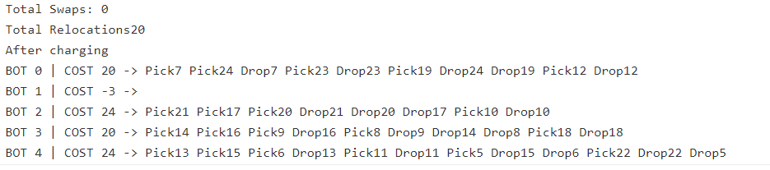
OUTCOMES AND LEARNINGS
It was great to be put in so much effort and dedication to this project.Learning so much in such a short constraint of time would be impossible given the absence of our mentors.
The final output if we put it down in words would be difficult as the learning curve was too steep in the implementation of the project.
However in a nutshell if we look at the code for lets say 5 robots and 20 orders with no additional constraints the output looked like
Where the travel time matrix is given and the picks and drop locations are assigned to the robots along with the schedule in which the orders are to be executed for a random travel time matrix.This was nothing short of a very humbling journey and helped me learn a lot of things.
Apart from technical things I also learnt how to deal with non technical things like teamwork,team spirit and so on.It also made me realise that I have a passion at working with algorithmic side of things and would like to work with like minded people and persevere to bring changes in the world with whatever little changes I can do.This was a great learning journey and I would like to thank everyone involved with me in this project.I would also like to extend my gratitude to our college for allowing me to pursue this opportunity and get a good knowledge into things which I would not normally would have been able to do through curriculum learning.I would like to thank everyone who remained supportive and cooperated with me throughout the process and made it an incredible learning journey.

Slide 17
Link to Code
https://github.com/Prashant43226/Robotics-Software-Internship
https://www.ideone.com/GhJk3U

Slide 18
THANK YOU

